Slide 1



The Threat to Compounded Hormones

Slide 2
Compounded bioidentical hormones (cBHT) are an essential medical therapy for millions of women who suffer the debilitating effects of hormone imbalance, usually caused by perimenopause and menopause.
“It has literally saved my life and my marriage. I wanted to die and I felt completely out of control until I got my hormones in balance."
—Michelle R.
Leander, Texas”

Slide 3
The FDA is considering new regulations that, if implemented, will deny access to a critically important, life-changing medical therapy to millions of people.
“It has literally saved my life and my marriage. I wanted to die and I felt completely out of control until I got my hormones in balance."
—Michelle R.
Leander, Texas”

Slide 4
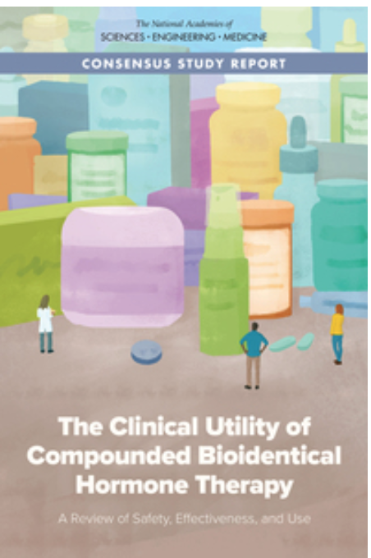
The skinny on the NASEM report
Paid for by FDA – $1.3 million in taxpayer dollars
Deeply flawed “study” that only considered a small fraction of the data available
Completely ignores the primary hormones prescribed by compounded hormone therapy
Ignores decades of positive patient outcomes
Committee included no pharmacists or physicians with actual experience in compounded hormones
Recommendations would usurp physicians’ judgment about proper therapies for patients
“It has literally saved my life and my marriage. I wanted to die and I felt completely out of control until I got my hormones in balance."
—Michelle R.
Leander, Texas”

Slide 5
Yes, FDA stacked the deck
NASEM’s work was not at all “independent”
Attorney for compounders submitted FOIA request for FDA/NASEM emails
Emails clearly reveal FDA inappropriately – and potentially illegally – influenced NASEM committee composition, research reviewed, and final recs
FDA told NASEM who should serve and how the study should go and which conclusions to make
Recommendations would usurp physicians’ judgment about proper therapies for patients
Read more: www.a4pc.org/smokinggun
“It has literally saved my life and my marriage. I wanted to die and I felt completely out of control until I got my hormones in balance."
—Michelle R.
Leander, Texas”

Slide 6
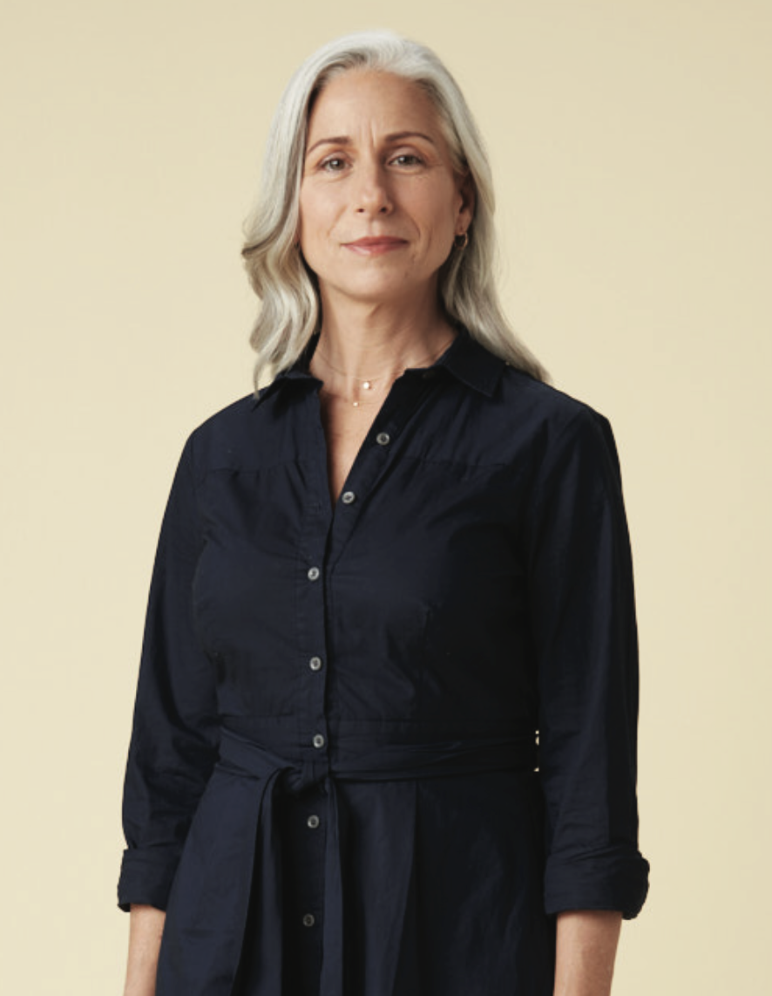
It is estimated that as many as 8 million patients currently take some form of compounded hormones, and their access will be taken away from them.
“It has literally saved my life and my marriage. I wanted to die and I felt completely out of control until I got my hormones in balance."
—Michelle R.
Leander, Texas”

Slide 7
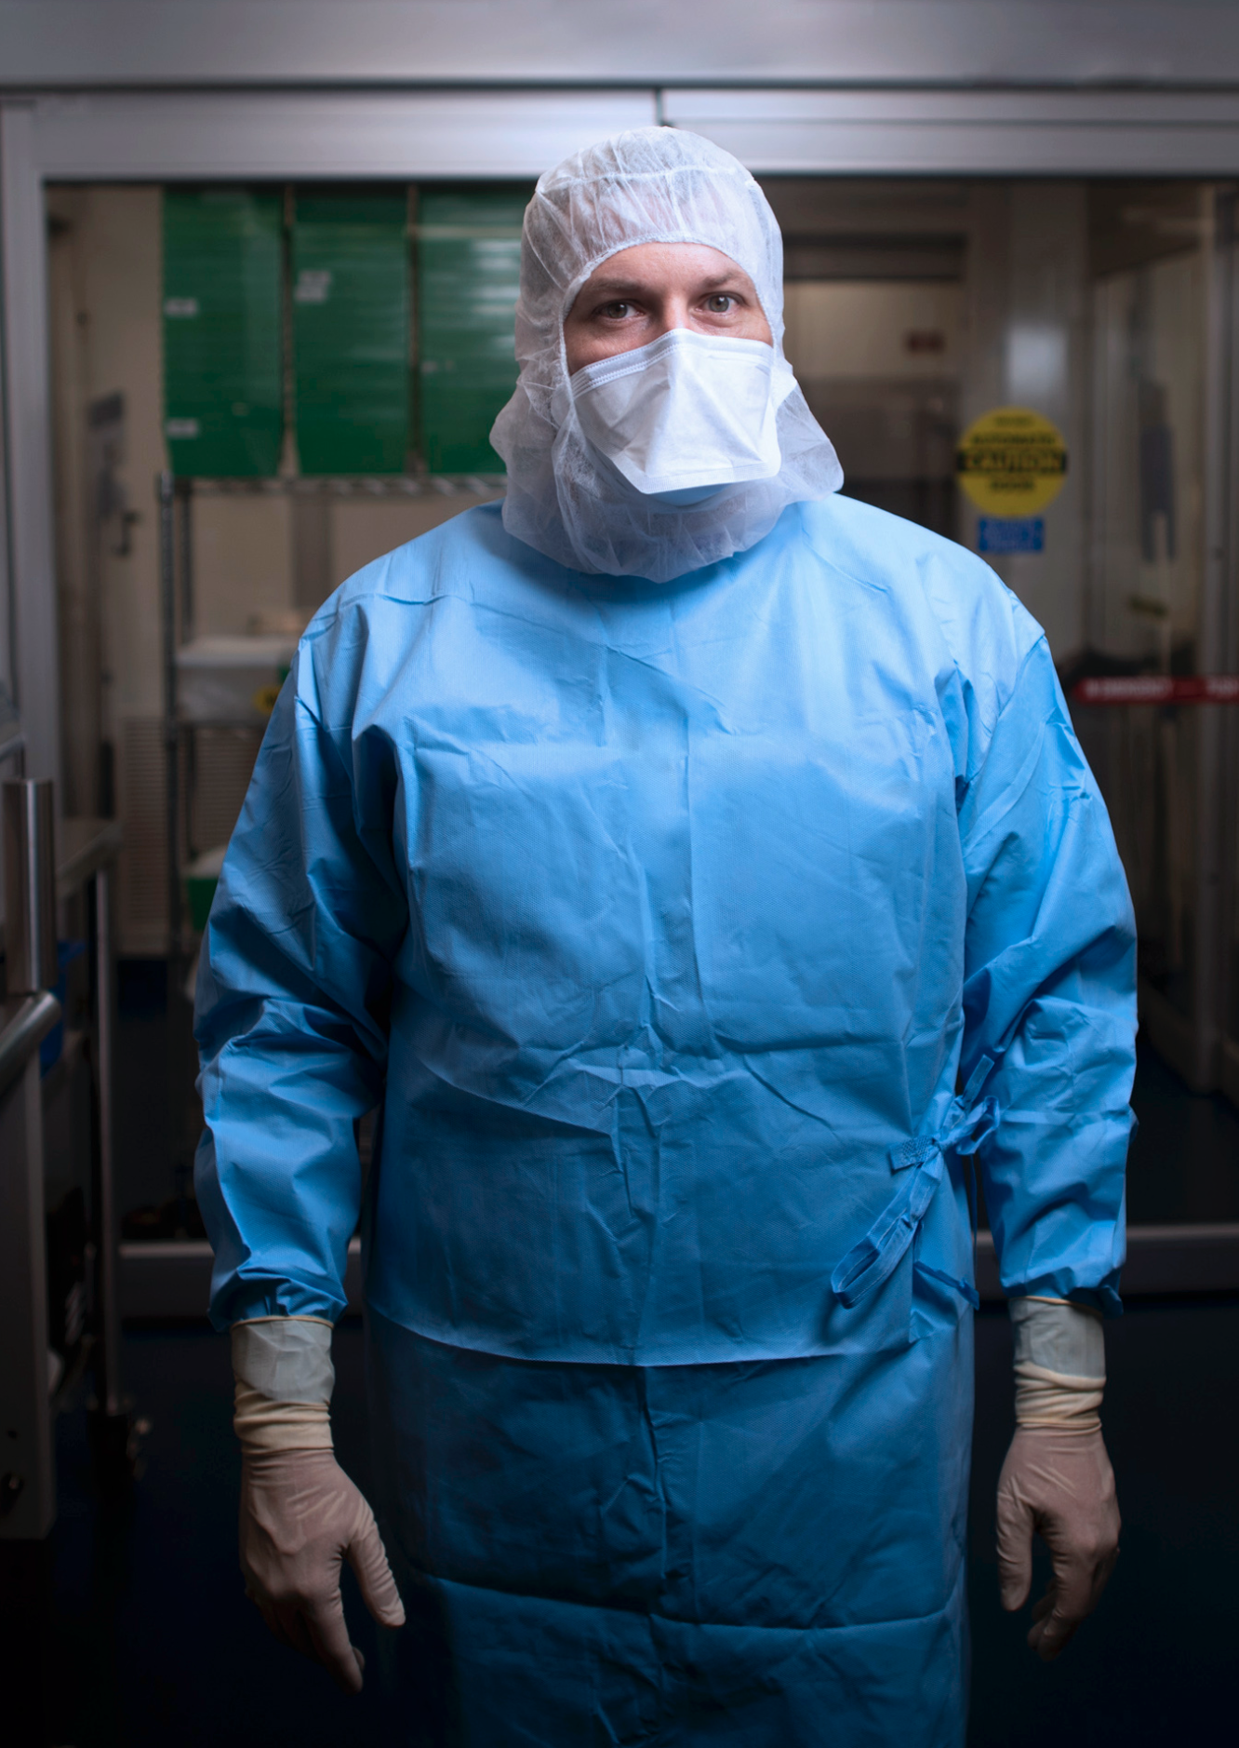
83% of compounding pharmacists recently surveyed said cBHT represents at least 20% of their practice.
“It has literally saved my life and my marriage. I wanted to die and I felt completely out of control until I got my hormones in balance."
—Michelle R.
Leander, Texas”

Slide 8
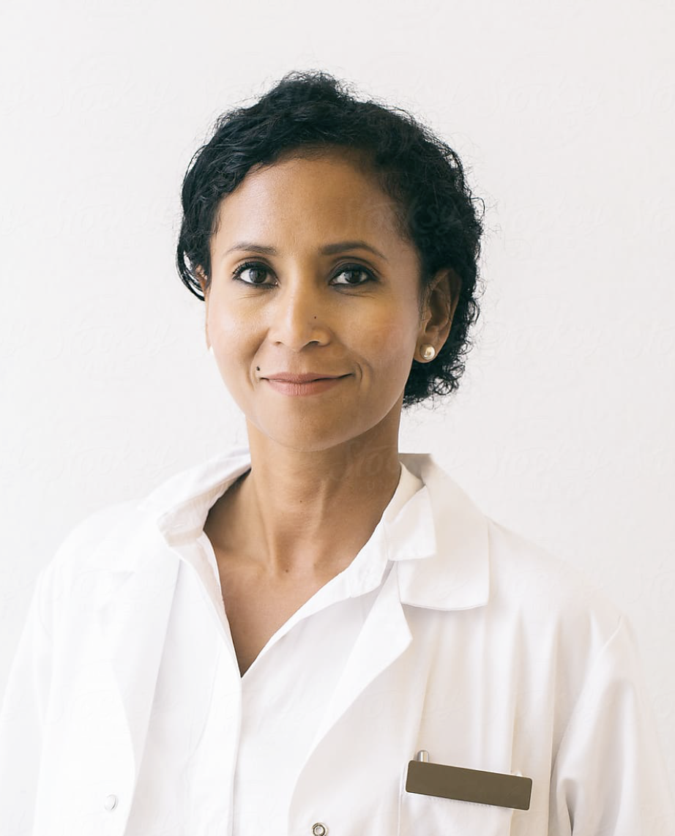
Physicians will have fewer treatment options for many, many patients for whom, in the judgment of the physician, FDA-approved manufactured drugs are not suited.
“It has literally saved my life and my marriage. I wanted to die and I felt completely out of control until I got my hormones in balance."
—Michelle R.
Leander, Texas”

Slide 9
ACTION PLAN
Third-Party, Independent Analysis of NASEM Report
Funded by the Pharmacy Compounding Foundation, this third-party analysis of the many flaws and biases inherent in the FDA-commissioned NASEM Report will illustrate inappropriate FDA meddling in the process, as well as the incomplete and misleading recommendations of the report. Release date: Late March 2021
$1.5M Media Effort
to create awareness and action among consumers, prescribers and pharmacists.
to urge Congress to investigate the issue, hold hearings and demand the FDA consider patient outcomes and the toll on patients across the United States if compounded hormones are restricted.

Slide 10

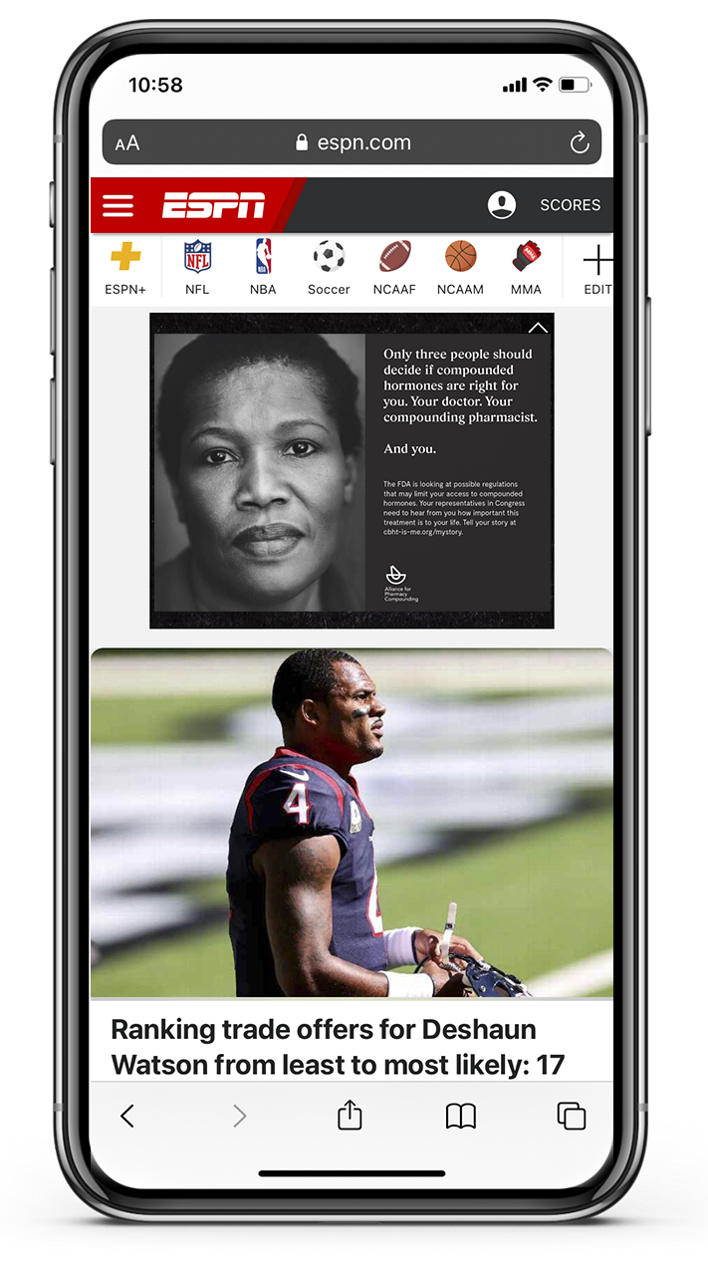
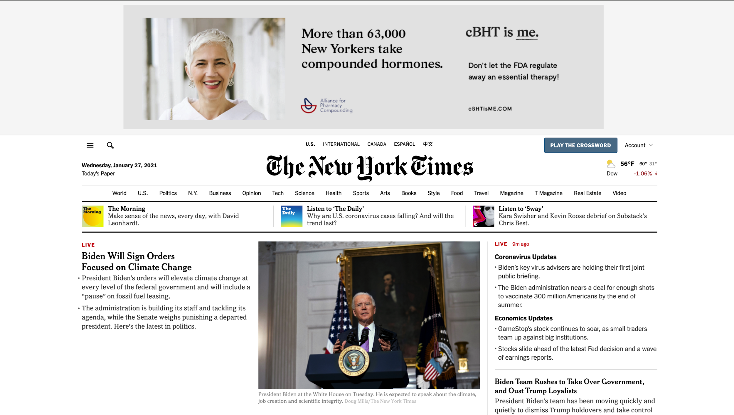

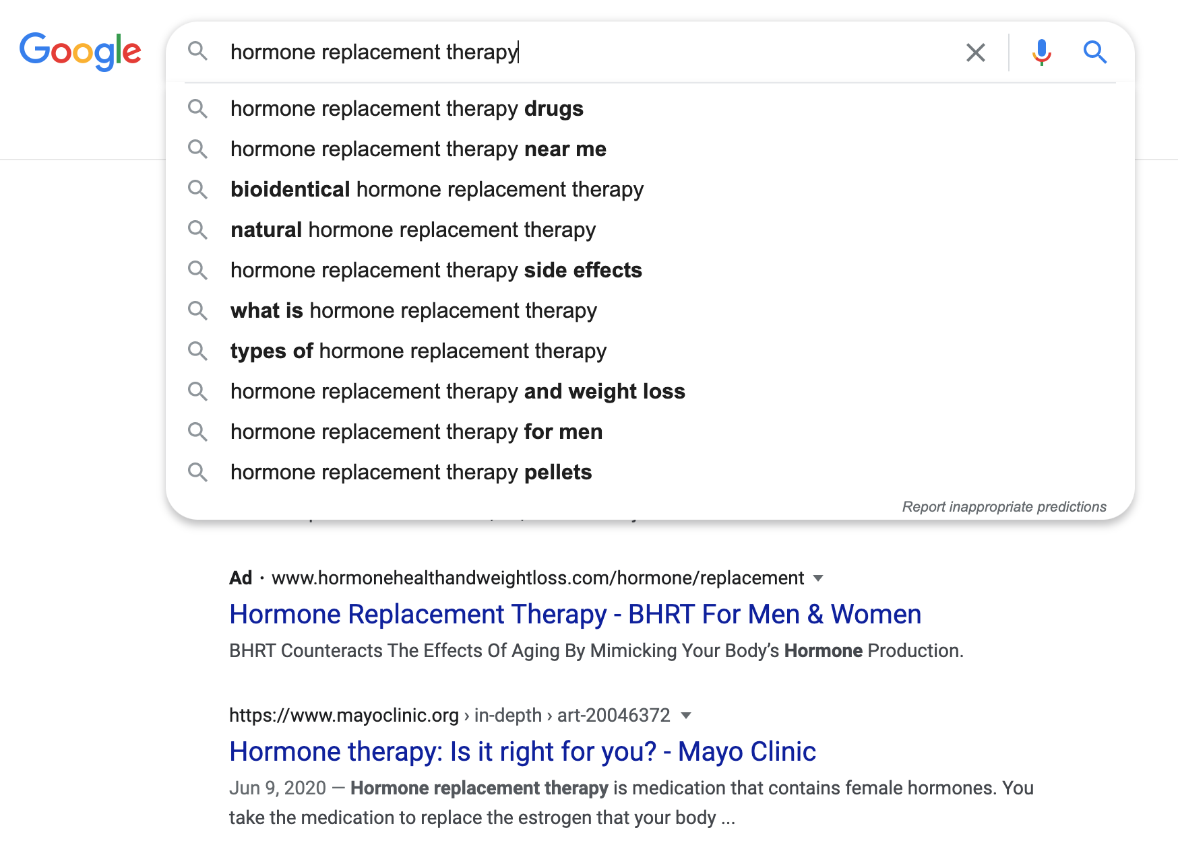



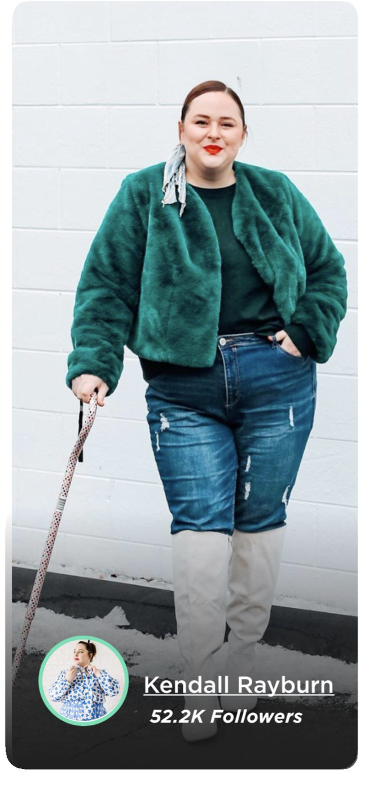


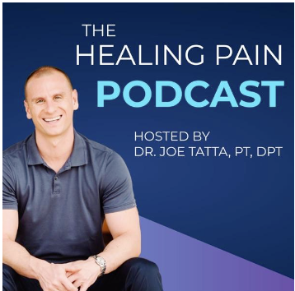

Reach 24,000,000 patients, professionals, members of Congress & staffers, via:
Digital Media
Podcasts
Influencers
Connected TV
Public Relations
Grassroots Marketing
Notes:
4.5 cents a touch

Slide 11
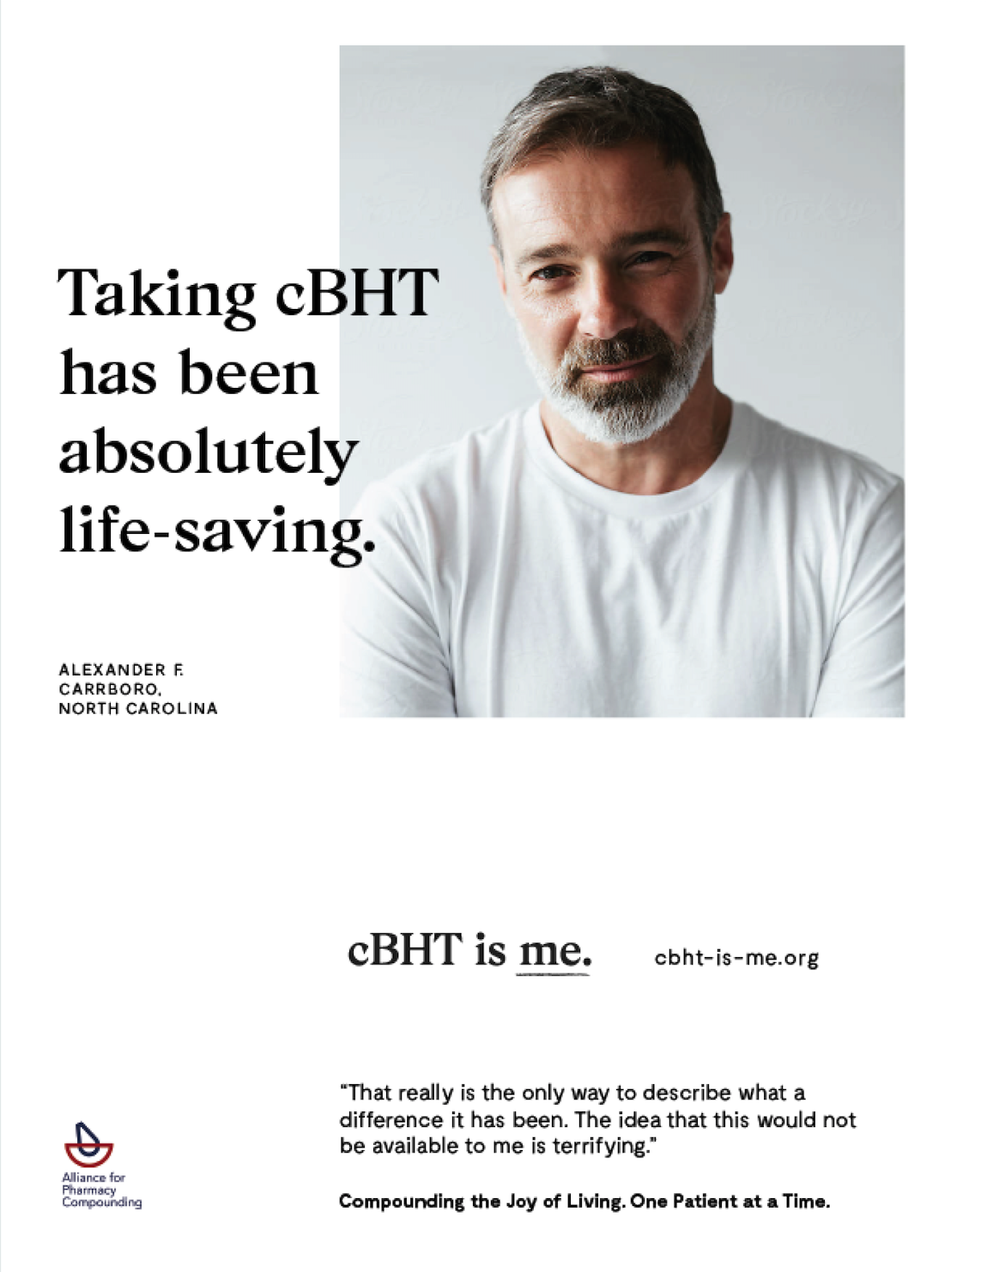
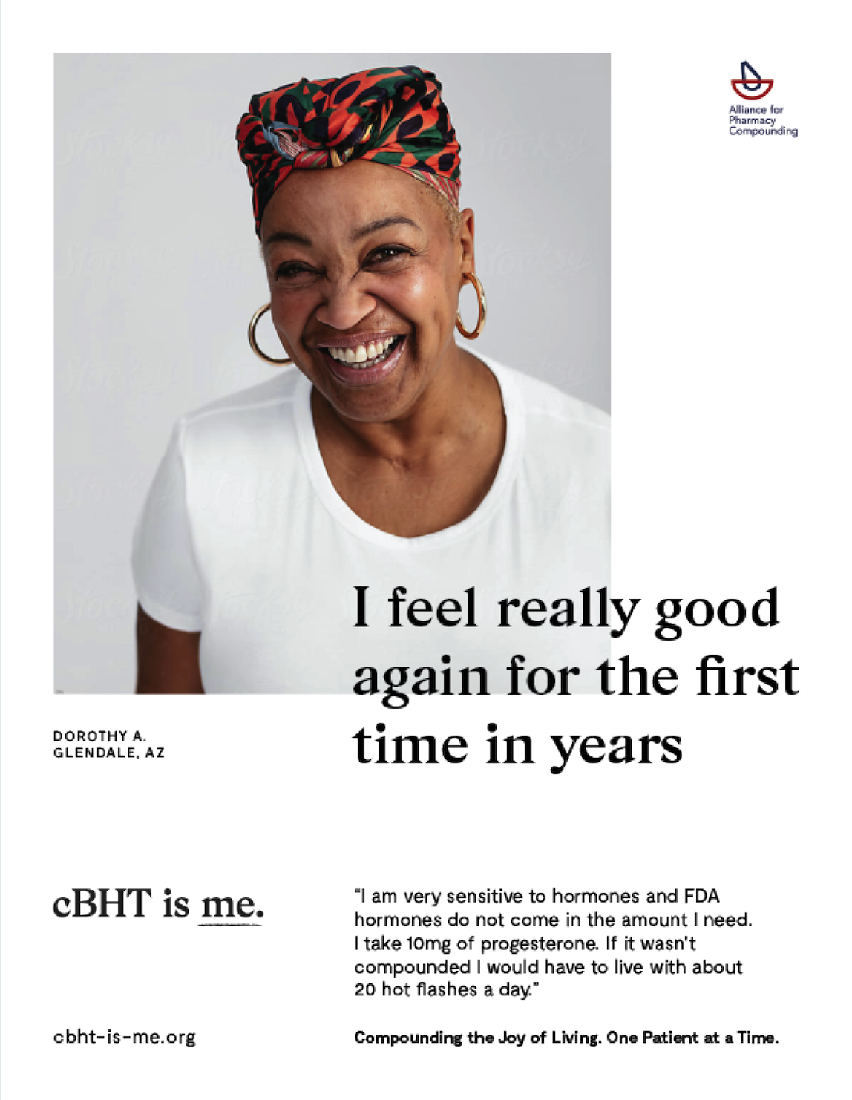
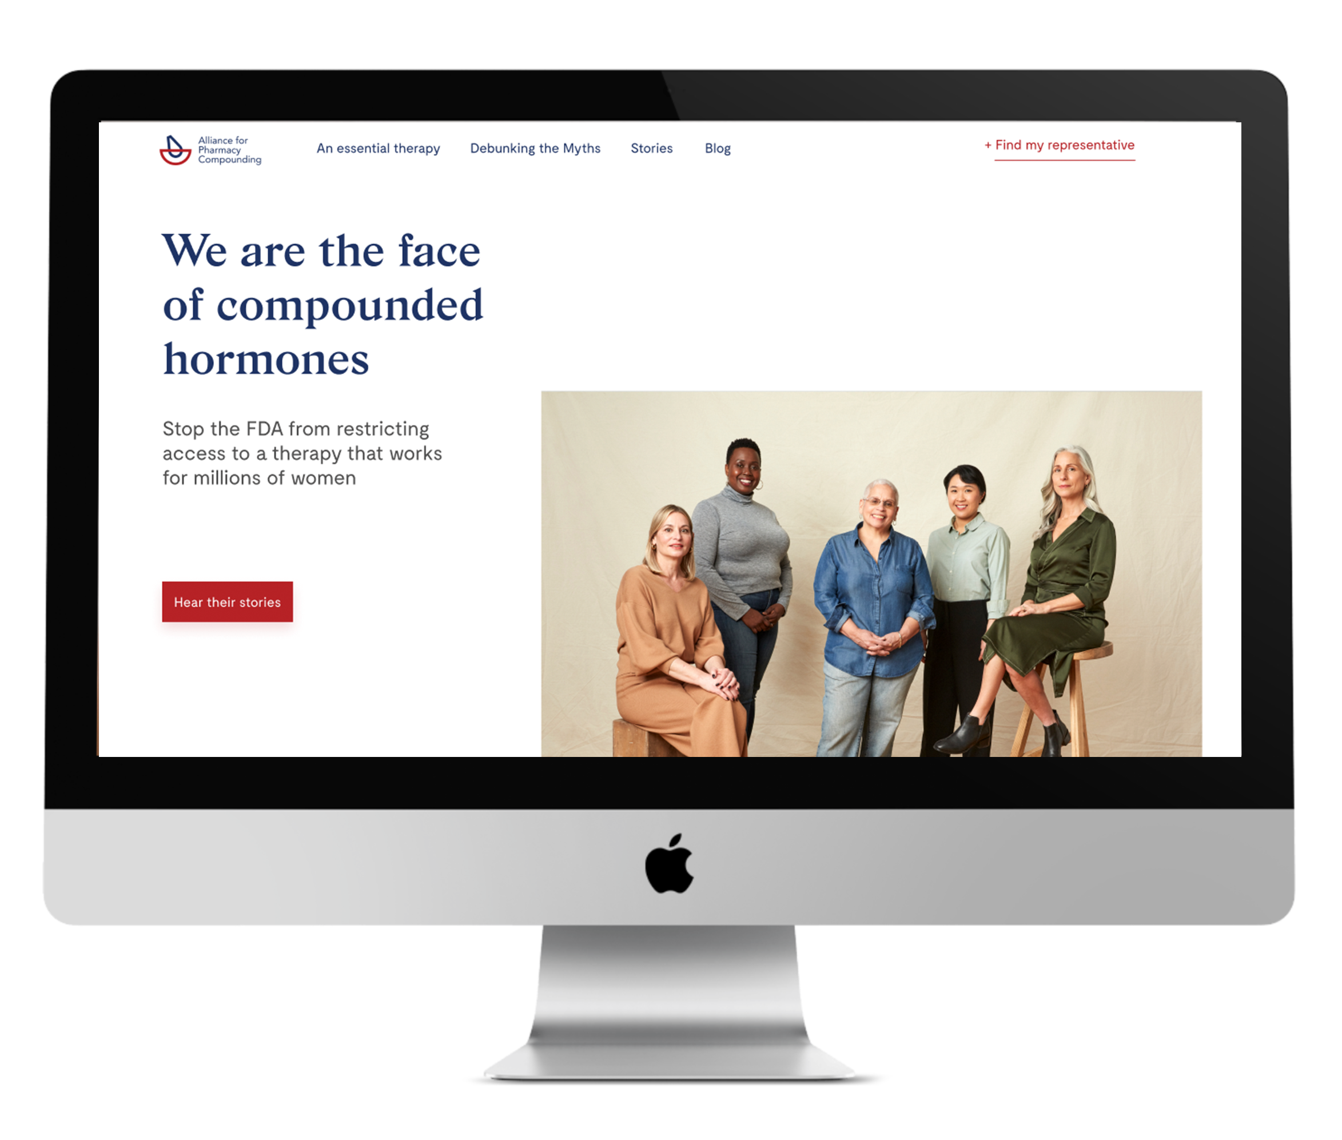
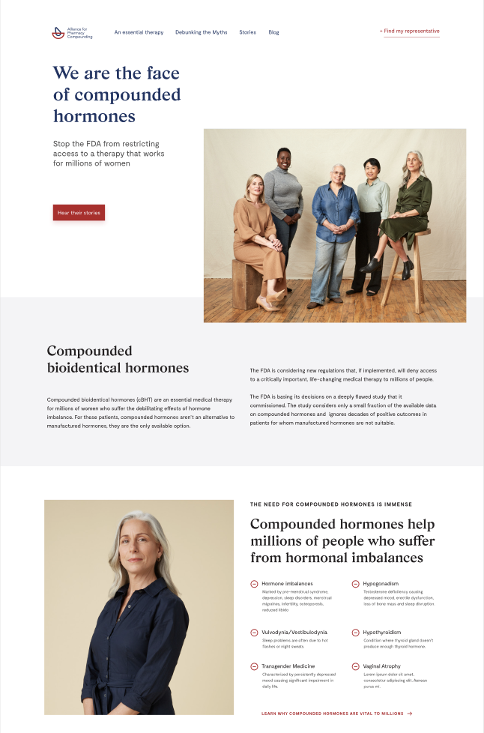
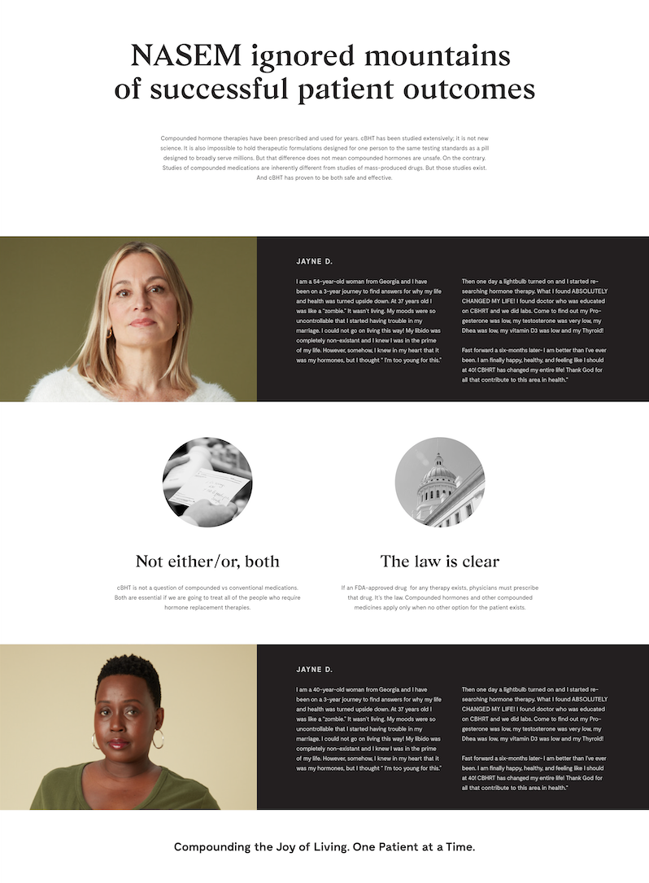
Initiative Objectives:
Show the value,
Share the threat,
Take action
Notes:
Short Term: Create awareness of the threat to cBHT and the
potential impact to patients, pharmacists and prescribers, and
call to action patients, pharmacists, prescribers and Congress.
Long Term: Create awareness of compounding pharmacy and the vital role it plays in the healthcare landscape.
---
Lets show the 3 target focuses, and the plans

Slide 12
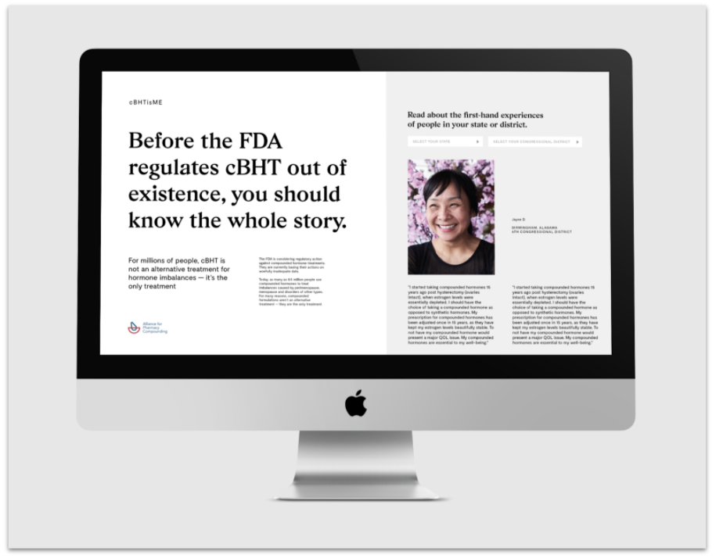
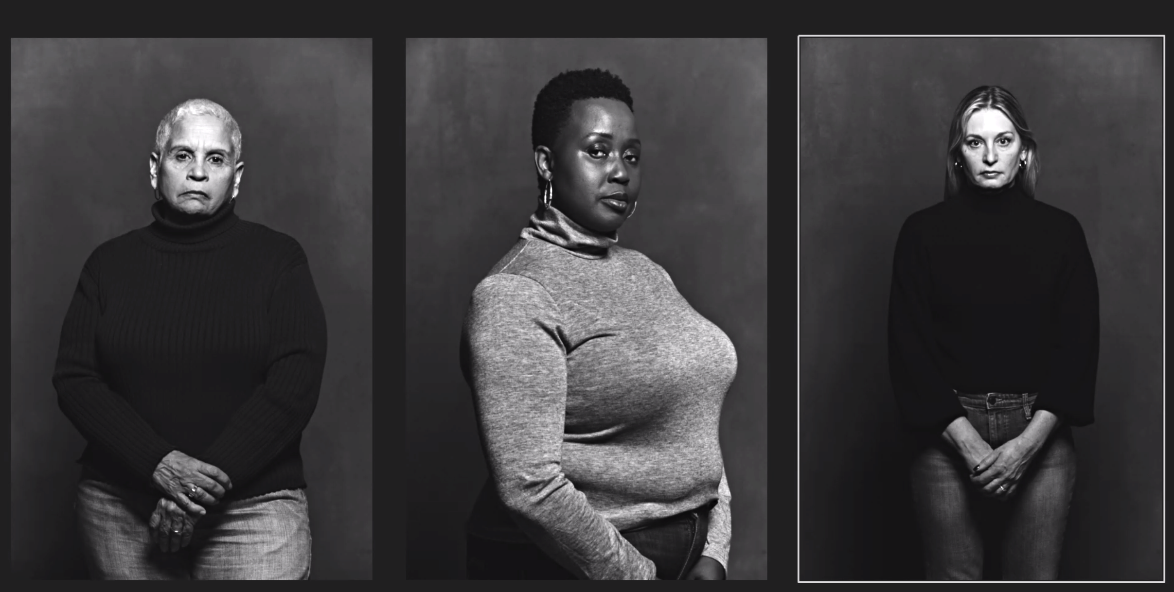
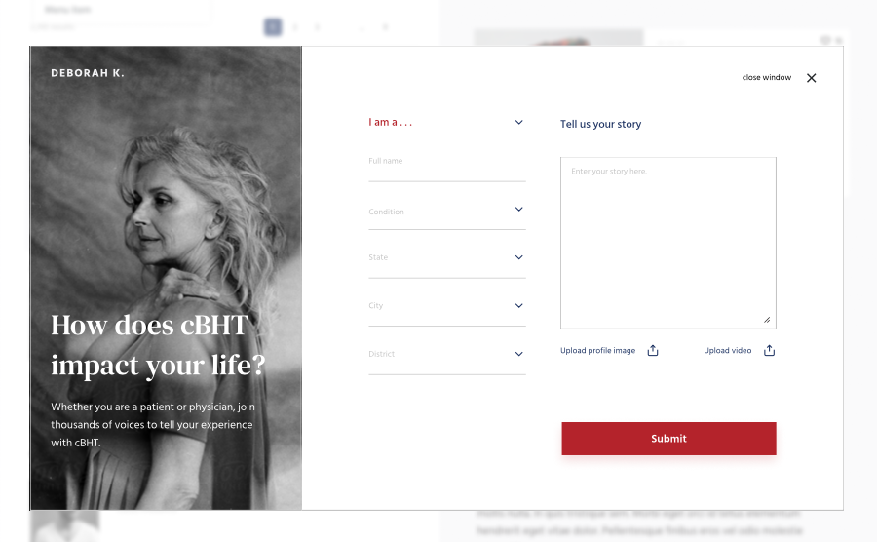
Notes:
Stories: The pharmacy compounding story is being told by people with a vested interested in disrupting or even shutting down the industry.
If we do not want to be defined by others, we have to step in and tell our story, the story of the industry but more so the story of the patients
Without much effort stories, in 2mo >3,500 of them, poured forth. Nationally...powerful one
Objective: every district, every state...powerful and personal and directly connected

Slide 13
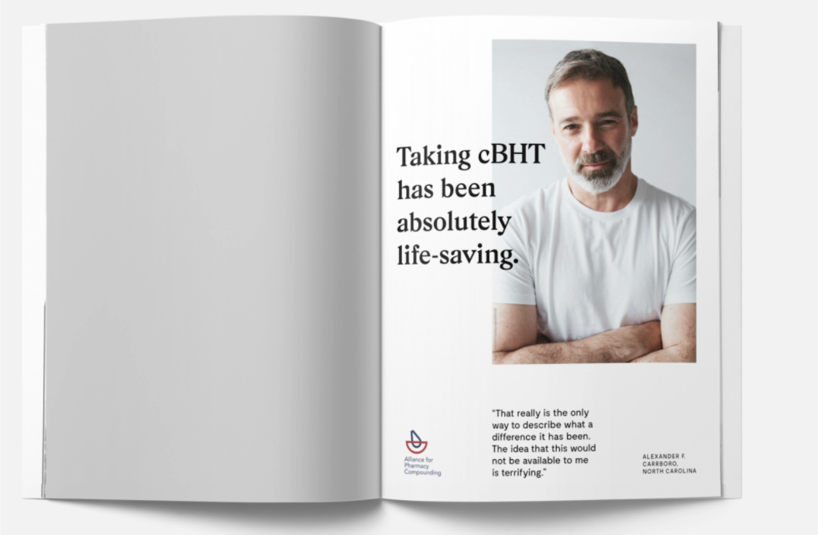
“It has literally saved my life and my marriage. I wanted to die and I felt completely out of control until I got my hormones in balance."
—Michelle R.
Leander, Texas”
Notes:
Stories:
We are narrow and exact in message and focus ...they are broad and working on many issues
We Have tight personal relationships with the patients who use compounded hormones. these patients are passionate because what the pharmacist and caregivers have done for them has been life-changing
Use in many ways
In store, on air, social...

Slide 14
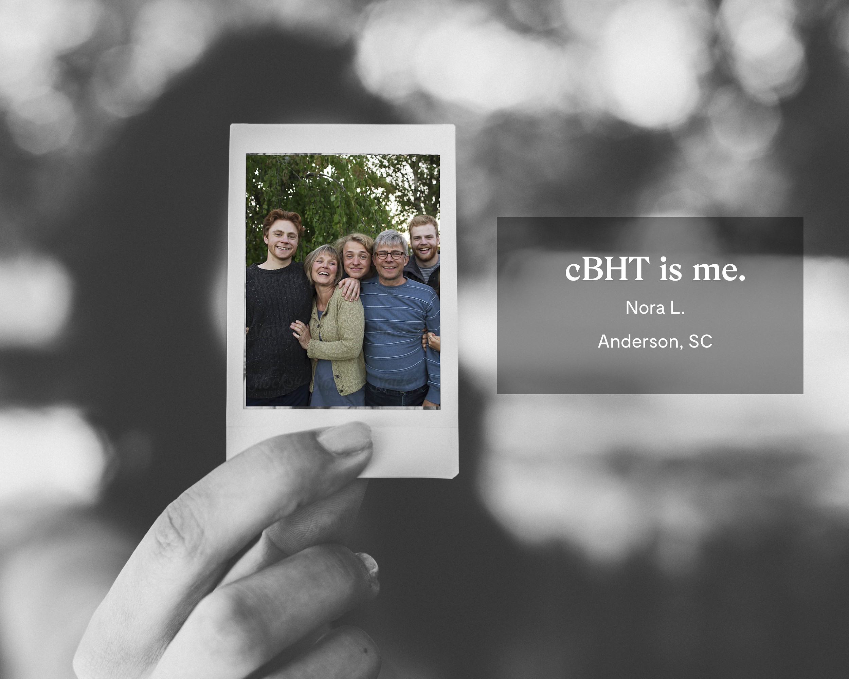
“It has literally saved my life and my marriage. I wanted to die and I felt completely out of control until I got my hormones in balance."
—Michelle R.
Leander, Texas”
Notes:
VIDEO...most powerful toolof our day
In the testimonial videos, we are using a spokesperson who will read a series of letters, to all members of Congress, that are first-person testimonials from people who live by cBHT. At the end of each testimonial letter, the spokes person will hold up a portrait/family shot of the person reading the letter and say, essentially: cBHT is me. And then the person's name.

Slide 15
WHAT CAN YOU DO?
Educate yourself and your patients about the threat
After April 1, direct them to compounding.com to share their compounded hormones story. (You can share your story, too!)
At compounding.com, they can also share their story with their member of Congress

Slide 16
WHAT CAN YOU DO?
Support the campaign financially. Your gift can help APC reach its $1.5 million goal to fund media placements.
(We’ve already raised almost half the needed funds!)
Give at www.a4pc.org/cbht

Slide 17
Questions?
Contact APC at info@a4pc.org

